Slide 1
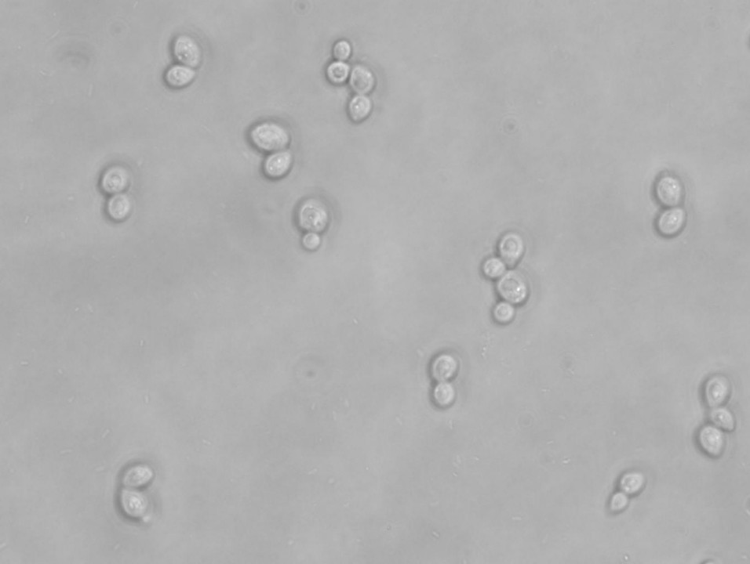
Candida auris
This Photo by Unknown Author is licensed under CC BY-SA
By Jen Reynolds, MS-Biology, MLS-AMT, M-ASCP, Certified in Emerging Diseases, Certified Instructor, Infection Preventionist, Haywood Regional Medical Center

Slide 2
Learning objectives:
Recognize the structure of Candida auris yeast and identify it on a Gram stain
Explain the growing resistance and resistance mechanisms of the yeast
List infections caused by Candida auris
Recognize the signs and symptoms of Candida auris infections
State the mortality rate of those infected with Candida auris
Recognize the risk factors for infection with Candida auris
List the treatments for infection with Candida auris

Slide 3
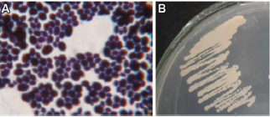
Candida auris: Structure
Candida auris is a yeast
On a wet mount, you will see Candida auris budding
It stains purple on the Gram-stain, as it retains the Crystal Violet stain, and is a large, oval-shaped yeast that may be budding
It is larger than Gram-positive cocci and it is a budding yeast that may or may not form short pseudohyphae
It does not form germ tubes
Grows well at 40-42 degrees Celsius
This Photo by Unknown Author is licensed under CC BY-NC-ND
This Photo by Unknown Author is licensed under CC BY

Slide 4
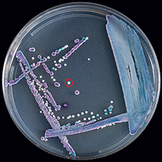
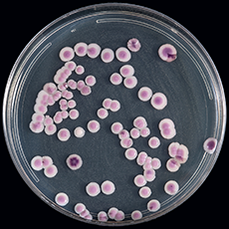
Growth on chromagar:
On chromogenic media, the colonies typically appear white or pink, but may be red or purple

Slide 5
Other laboratory tests:
MALDI-TOF can differentiate it from other Candida species.
Molecular methods can also sequence it, including the BioFire FilmArray BCID2 in blood cultures.

Slide 6
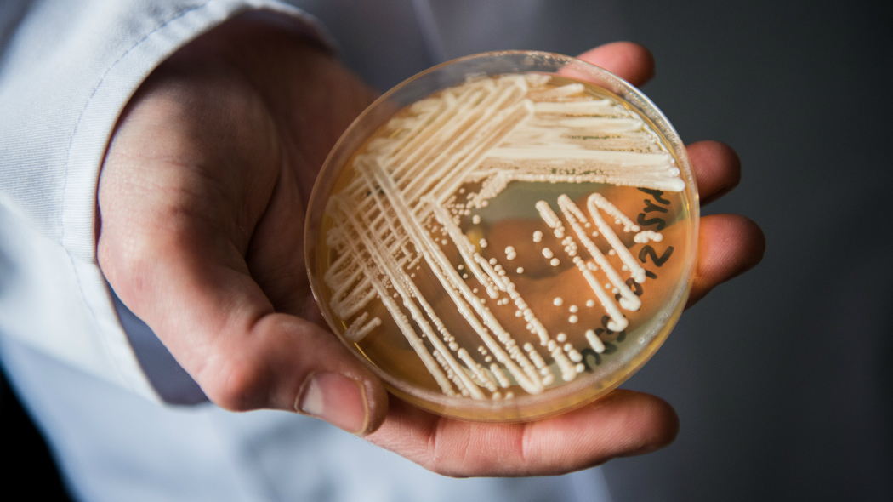
Candida auris:
https://youtu.be/2AkI5NeD4Ec
This is a type of yeast that can lead to severe illness
The concern is that is spreads easily among patients in healthcare facilities
It is often resistant to antifungal treatments
It was just discovered in 2009
It has spread quickly and caused infections in more than 12 countries!
It can be difficult to identify or misidentified
It can spread in healthcare facilities and nursing homes.
It is still rare in the USA.
This Photo by Unknown Author is licensed under CC BY-NC-ND

Slide 7
Infections and symptoms:
It can cause a variety of infections in the body, including:
Bloodstream (fungal sepsis)
Open wounds
Ear infections
Symptoms vary based on location and severity
Most common symptoms include fever and chills that do not improve with antibiotic treatment for a suspected bacterial infection
This Photo by Unknown Author is licensed under CC BY-SA

Slide 8
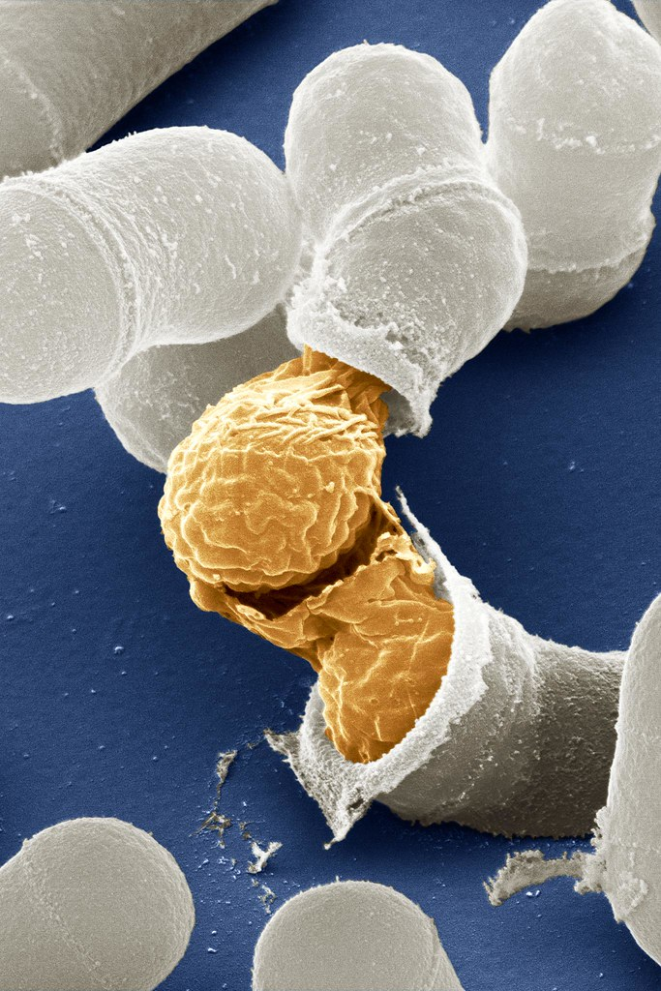
Colonization:
Another concern is colonization with this yeast
It can colonize the skin and mucus membranes
People can be asymptomatic carriers
It can still be transmitted to others or to surfaces or objects, which can spread it to others
This Photo by Unknown Author is licensed under CC BY-NC

Slide 9
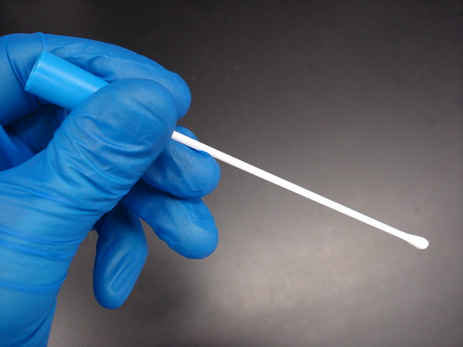
Diagnosis: testing and screening
Colonization Screening
A swab can be collected from the skin, by swabbing the axillary area (armpits) or groin and sending it to a laboratory for testing
Clinical Specimen Testing
For symptoms of infection, a healthcare provider can collect a clinical sample (blood, urine, wound pus, etc…) and culture it for identification and susceptibility testing
Positive samples must be reported to infection prevention and control, who reports it to the state health department
This Photo by Unknown Author is licensed under CC BY-SA-NC

Slide 10
Not a threat to healthy individuals:
Despite what the media may portray, in general, this yeast is not a threat to healthy individuals
The CDC does not recommend screening or testing family members
Family members and healthcare workers should use alcohol-based hand sanitizers or wash their hands with soap and water before entering and before leaving a patient’s room, and before and after contact with the patient or their environment

Slide 11
Risk factors:
This organism mainly affects patients with severe underlying medical conditions requiring complex medical care
Those at risk include those who have:
Invasive or indwelling medical devices
Breathing tubes
Feeding tubes
IV catheters
Urinary catheters
This Photo by Unknown Author is licensed under CC BY

Slide 12
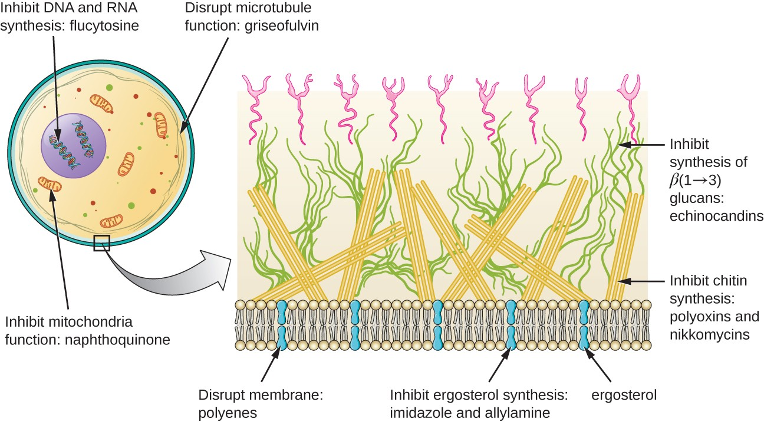
Resistance and treatment:
Candida auris is often resistant to commonly used antifungal medications
Most infections are treatable with a class of antifungal medications known as echinocandins
Some strains are resistant to all three main classes of antifungal medications, requiring the use of multiple antifungal medications or newer ones
If someone is colonized, and do not have symptoms of infection, then they do not need to be treated
This Photo by Unknown Author is licensed under CC BY

Slide 13
Outcomes:
A variety of infections can be caused by this organism:
Superficial skin infections
Deep wound infections
Heart infections
Brain infections
Severe, life-threatening blood infections (invasive)
Most dangerous type
At highest risk are those in the hospital and nursing homes
More than 1 in 3 patients with this type of infection die

Slide 14
Preventing spread:
For a patient who is colonized or infected, healthcare providers can take extra measures to prevent the spread:
Transmission isolation precautions: contact
Cleaning the room and equipment with special disinfectant products, since it can live on surfaces for several weeks
Wearing gowns and gloves to deliver patient care
Following good hand hygiene
This Photo by Unknown Author is licensed under CC BY-ND
This Photo by Unknown Author is licensed under CC BY

